Slide 1

Some UNIX Development tools
OS course for CS 2024B

Slide 2
Shell and shell built-in, file utils
Shell – the command prompt (“cmd”, “black screen”)
The default shell we use is a flavour of the Bourne shell called bash
Programmable scripting environment (like ”powershell” in windows)
Has many builtins (try set VARIABLE=‘value’) and echo $VARIABLE
pushd, popd – like “cd” with stack
!! Run last command again
!history – show all commands I previously run
!2 – run command #2
!-2 – run 2 commands ago - again
Mostly beyond scope – check out unix is a 4 letter word

Slide 3

shell – important environment variables
Echo $prompt (or set prompt) – display the command prompt
$PATH – where to look for binaries
$DISPLAY – where to open graphics display
$TERM – some information about the terminal I am using

Slide 4
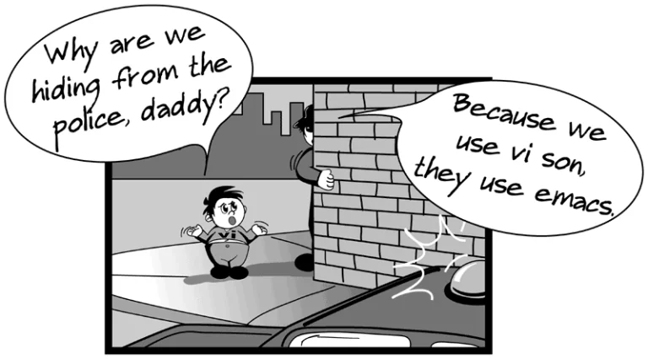
File utils and other interesting binaries
/bin/cp(1) – copy (I will not add /bin/ anymore as it is in $PATH)
Find(1) – find files
Locate(1) – find files in db (updatedb(1) = update the db)
mv(1) – move
rm(1) – delete (remove)
sed(1) – stream editor
vi(1) – best editor in the world (IMHO)
nano(1) – recommended editor for noobs
emacs(1) – use this if you are devil spawn with 17 fingers (Linus Torvalds uses it!)
sudo(1) – superuser do

Slide 5
Development tools
gcc(1) – compiler, also linker
g++(1) – actually same as gcc - pointer to the same file. Knows by argv[0] its called as g++ and compiles c++ by default
make(1) – a programming language we will use to create project. We will study very basic make.
Automake(1), cmake(1), ant(1) – other projects that do the same thing. (sometimes by calling make eventually) – we will not be teaching those but it is ok to use them if you know them.
Valgrind(1) – a process virtual machine environment – (process virtual machine = like JVM or CLR. Not like Vbox or Vmware)
gcov(1) – code coverage tool
gprof(1) – profiler

Slide 6
Code coverage
How do we know “we have don’t enough testing”?
Easy…. Never.
But perhaps we can prove we have done ”nearly enough”
Enter - Code coverage tool
We paint all our code in black.
Than when we run the code we paint all lines we have been at in red.
That can find some interesting problems

Slide 7
By covering almost all the code we can find some logical bugs and dead code

Slide 8
Dead code
If (x>4) do something
else if (x<2) do anotherthing
else if (x>5) do dettathinghere
else do theoddathingy
The way this if is structured we will never do “dettathinghere”
This is called dead code.
We will spot this with code coverage

Slide 9
Achiving maximum (100%) coverage in testing is sometimes impossible
Some conditions are very hard to simmulate (for example malloc to fail on a given specific line)
Code that detects hardware failures etc.
So 100% coverage is not really required
But have a good reason not to cover 100%

Slide 10
Code coverage testing is neccessary but insufficient
For examle consider the following code
Socket()
Bind()
Listen()
Accept()
This code may work (assuming the arguments to system calls are correct) but may also fail.
We can reach 100% coverage and still not find the case of bind failure because address is already in use.
Other similar logical cases may occur (for example poping an empy stack and not handling it, reading faulty variables causing buffer overflow etc.)

Slide 11
I will request code coverage report on future exercises
Just to make sure that atleast you tested your work.

Slide 12
gprof(1)
Most code can be optimized some optimzation are very easy
Examples include inlining function, passing less arguments using structs, unrolling loops, saving temporary computations, using assembler and sacrificing portability etc.
But we don’t know what to optimize
Optimizing hurt readability, code reuse, portability etc. for examle we want to replace calling rand(3) to ASM call RDRAND) hurts all three.
Assuming Pareto is right (80%/20%. Usually its more like 90%/10%) we would like to optimize only the 10% of the code where we spend 90% of the time.
But how to find this 10%?
Programmers hunches are usually wrong

Slide 13
Valgrind(1)
We will have a class specifically on valgrind so its not cover in ex1.
Valgrind is a VM that allows running all sorts of tools to better test our code.
Memcheck – a bounds checker
Call graph – generate control flow graph
Helgrind – thread debugger

Slide 14
All of those are interesting

Slide 15
Make – the 1% that is sufficient for 99% of the projects
<What to build> : <depends on>
<tab><how to build 1>
<tab><how to build 2>
<tab><how to build 3>
<LF>
<What to build 2> : <depends on>
<tab><how to build 1>
<tab><how to build 2>
<tab><how to build 3>

Slide 16
example
edit : main.o kbd.o command.o display.o insert.o search.o files.o utils.o
cc -o edit main.o kbd.o command.o display.o insert.o search.o files.o utils.o
main.o : main.c defs.h
cc -c main.c
kbd.o : kbd.c defs.h command.h
cc -c kbd.c
command.o : command.c defs.h command.h
cc -c command.c
display.o : display.c defs.h buffer.h
cc -c display.c
insert.o : insert.c defs.h buffer.h
<tab>cc -c insert.c
search.o : search.c defs.h buffer.h
<tab>cc -c search.c
files.o : files.c defs.h buffer.h command.h
<tab>cc -c files.c
utils.o : utils.c defs.h
<tab>cc -c utils.c
clean :
<tab>rm edit main.o kbd.o command.o display.o \
insert.o search.o files.o utils.o

Slide 17
Maybe an extra 1%
VARIABLE = value – how to set a variale
DEBUG = 1
Ifeq ($VARIABLE, “value”) – if variable is equal value
$@ - current target
$< - what current targets depends on
Syntax :
ifeq ($(CC),gcc)
$(CC) -o foo $(objects) $(libs_for_gcc)
else
$(CC) -o foo $(objects) $(normal_libs)
endif

Slide 18
And some time saving example
$(OBJDIR)/%.o : %.c
$(COMPILE.c) $(OUTPUT_OPTION) $< -o $@

Slide 19
Make has much more to it.
But its not necessary and we don’t have time.
https://www.gnu.org/software/make/manual/make.html
Perhaps some of it will allow you to automate tasks and do things faster in the long run.

Slide 20
Gdb(1)
The master of debugging
The back-end behind all debuggers
If gdb can’t do it – it cant be done.
If your favorite debugger is doing something – it passes some commands to gdb and gdb can do the same

Slide 21
Some simple gdb
gdb – invoke gdb(1)
gdb –tui = gdb textual user interface. (Try in FreeBSD) also try cgdb(1)
ddd(1) – display data debugger (X windows front end)
TRY - https://beej.us/guide/bggdb/

Slide 22
Core dump
Viewing a process after it crashed.
Great way to view a process and find out
Which line it crashed on
How it crashed
And why
Required enabling cores.

